Slide 1

Purdue Process Safety & Assurance Center (P2SAC)
Overview
Ray A. Mentzer
Professor of Engineering Practice
Associate Director, P2SAC
Charles D. Davidson School of Chemical Engineering
Purdue University
December 15, 2022

Slide 2

December 2022 Conference Registration
Sponsors
ACC – Am Chem Council
AcuTech
AMGEN
Chevron
Corteva
CountryMark
Dow
Endress+Hauser
ExxonMobil
Fauske & Associates
GSK
Honeywell
JMJ
Kenexis
Lilly
Marsh Risk
Pfizer
SABIC
Vertex
3M
Guests
Abbvie
Air Products
Aramco*
BMS
CCPS
CDC - NIOSH
Cook
Cummins
DEKRA
DPR Simulations
Evonik
Grace
IDL Ventures
ISPRA*
Jensen Hughes
Johnson Matthey
Langan Eng & Env
Merck
Metler Toledo
Olon Ricerca BioSc
Promega Corp
Sandia Nat’l Labs
Snapdragon Chem
Syngena Int’l
Tate & Lyle
Thermal Haz Tech
Univ of Alberta*
Univ of Wisc
*denotes 1st meeting
On-going dialog with other Depts:
ABE, CHEM, IE, IPPH & ME

Slide 3
Growing Industry Participation & Projects in P2SAC

Slide 4
Prof Masters Capstone Projects 2022 - P2SAC Related
AcuTech, ExxonMobil & Kenexis - Hazards / PHA associated with hydrogen
production
Chevron - Ocean-Based Carbon Dioxide Removal
Corteva - Expand RHEACT (Reactive Hazard Evaluation & Compilation Tool) capabilities to include heats of reaction
- Heat Transfer and Hydraulic Model of Agitating Nozzles
- Self-Optimizing Reactor Platforms
ExxonMobil - Use of Water to Mitigate a Bromine Loss of Containment Event
Fauske - New application of ARSST calorimeter
JMJ – Hydrogen value chain; production, storage, transportation & use
Vertex (w / Amgen, Corteva, GSK, JM, Lilly, Merck) - Modeling Energetics of Molecules of Interest to the Pharma Industry; pyrazoles & aryl nitro cmpds

Slide 5
P2SAC Company Participation in PMP Capstone Projects
 |  | 21 - Spring |  | Summer |  | 21 - Fall |  | 22 Spring |  | Summer |  | 22 -Fall
ACC |  | x |  |  |  | x |  | x |  |  |  | x
AcuTech |  | x |  |  |  |  |  |  |  |  |  | x
Amgen |  |  |  | x |  | x |  | x |  | x |  | x
Chevron |  |  |  | x |  |  |  |  |  | x
Corteva |  | x |  | x |  | x |  | x |  | x |  | x
Dow |  |  |  | x
ExxonMobil |  |  |  |  |  | x |  |  |  | x |  | x
Fauske |  |  |  | x |  | x |  | x |  | x
GSK |  |  |  | x |  | x |  | x |  | x |  | x
JMJ |  |  |  |  |  | x |  |  |  | x |  | x
Kenexis |  |  |  |  |  |  |  |  |  |  |  | x
Lilly |  |  |  | x |  | x |  | x |  | x |  | x
Marsh |  | x
Merck |  |  |  | x |  | x |  | x |  | x |  | x
Phillips 66 |  |  |  | x
Vertex |  |  |  | x |  | x |  | x |  | x |  | x
Projects over prior years also included: BP, Country Mark, SABIC & 3M

Slide 6
2022 Undergraduate Research
Spring ‘22
Use of ARSST Calorimeter to Study Reagents Common to the Pharmaceutical Industry
Lightning strikes leading to process safety incidents; options to mitigate and best practices (ACC)
Shortcomings of Emergency Response systems, resulting in significant contribution to incidents
Fall ‘22
Energetics of molecules common in pharma industry; comparison of experimental data with CHETAH & TCIT (Purdue) models. (Amgen, Corteva, GSK, JM, Lilly, Merck, Vertex)
Comparison of risk assessment methodologies for pipelines, trucks & rail (AcuTech, ACC & ExxonMobil)
Assess ESG strategies of companies in various industries (oil & gas, chemicals, pharma…) including metrics & process safety (JMJ)

Slide 7

Process Safety Instruction in Chemical Engineering at Purdue University
Presented at AICHE Annual Meeting, Phoenix November 2022
Ray A. Mentzer
Professor of Engineering Practice
Associate Director, Purdue Process & Assurance Center (P2SAC)
Charles D. Davidson School of Chemical Engineering
Purdue University
November 16, 2022

Slide 8

In a nutshell …
Course itself:
  Rigorous, technical, quantitative - 3 credit hour process safety course required of all seniors; typically 170 students taught each academic year
  Cover nearly all of ‘Chemical Process Safety’ text by Crowl & Louvar, along with several add’l topics and CSB incident videos shown weekly
  Each team of three does thorough investigation of unique major incident using quantitative calculations & methodologies discussed in class; weekly homework
  Have not incorporated many software appl’s; nor use many guest lecturers
  Course taught for 7 yrs; replaced earlier industry focused non-technical course
Instructor:
  ~30 years experience with ExxonMobil, plus process safety teaching & research background from Texas A&M and Purdue
Results:
  Well-received by companies recruiting ChEs – oil & gas, specialty chemicals, pharmaceuticals, manufacturing, etc
Department culture / commitment:
  Aided by ‘Purdue Process Safety & Assurance Center’ with two conferences each year, ~25 UG, MS & PhD projects per year & multiple faculty engaged from various departments

Slide 9
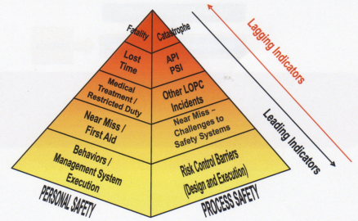
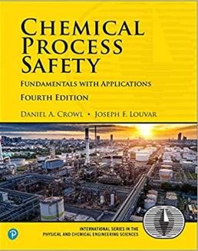
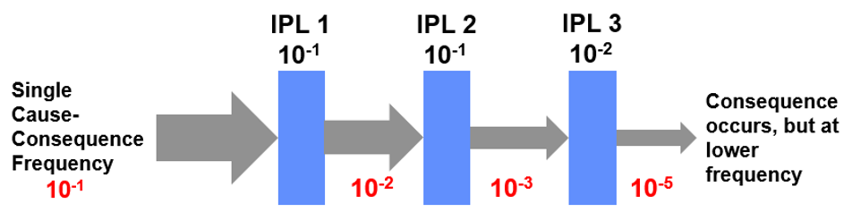
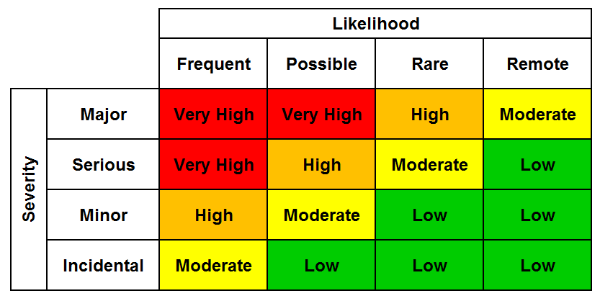
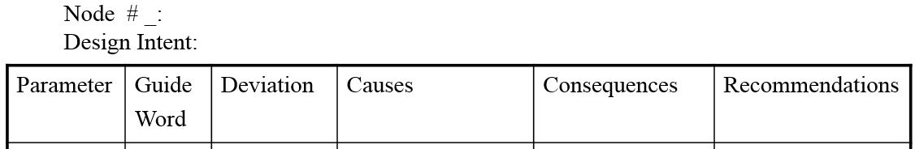
Chemical Process Safety - Core Class
  The Basics
  Consequence Modeling
  PHAs & Risk Assessments
  Incident Investigations & Emergency Response
Process Safety Metrics
LOPA Frequencies
Typical 4x4 Risk Matrix
HAZOP

Slide 10
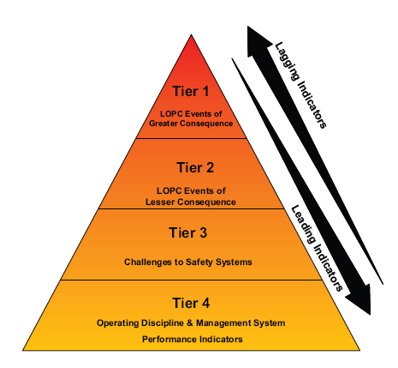
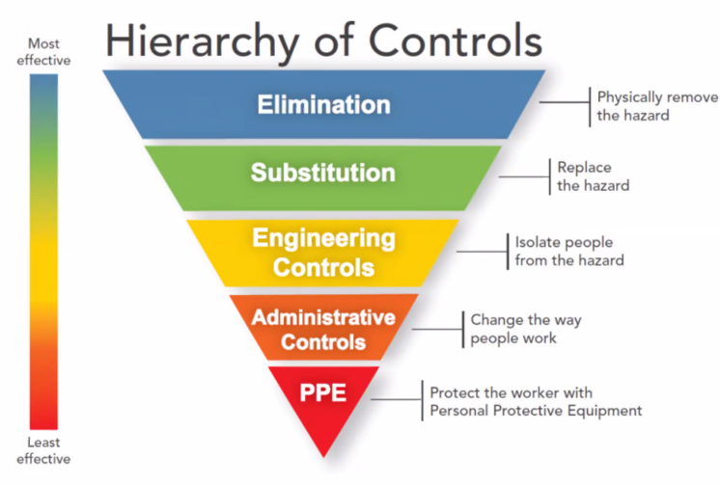
The Basics
  Personnel vs. Process Safety and
  applicable metrics
  Safety culture
  Leading / lagging metrics
  Inherently safer design
  Ethics
  Applicable regulations
  OSHA PSM
  EPA RMP, CFATS, RAGAGEP, Mgmt Systems

Slide 11
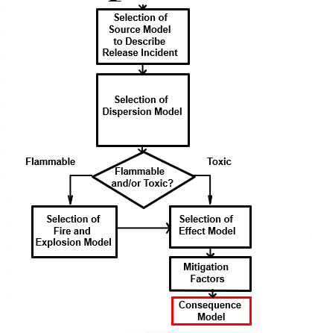
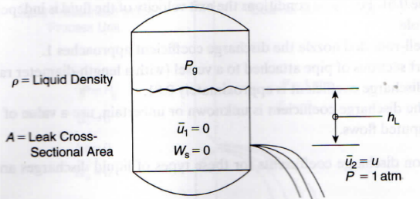
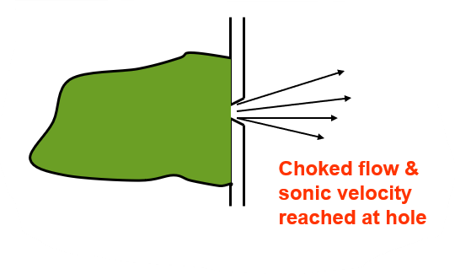
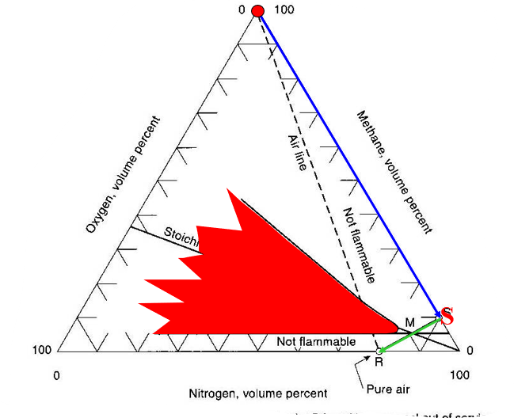
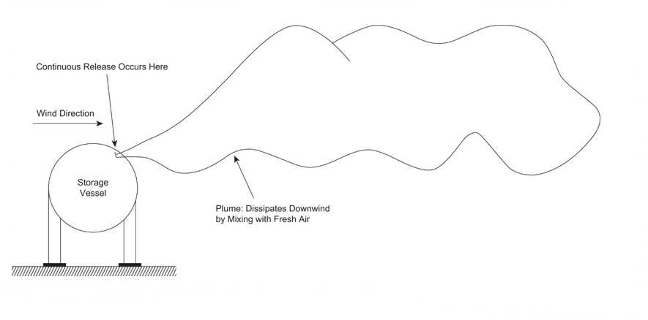
Consequence Modeling
  Source Term Modeling
  Liquids, gases …
  Worst & alternate release scenarios
  Toxicants & Industrial Hygiene
  GHS & SDSs
  Hazard evaluation – probits, toxicants, noise
  Dispersion Modeling
  Plumes, puffs, Pasquill-Gifford model
  ERPGs vs. TLVs …
  Fires & Explosions & Prevention
  Flammability diagrams; UFL, LFL, MIE …
  Dusts
  Deflagration vs. detonation; TNT equivalency modeling
  Inerting vessels
  Static electricity
  Chemical Reactivity
  - CRW, calorimetry & data analysis

Slide 12
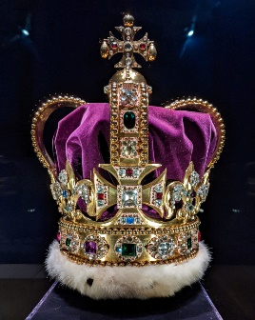
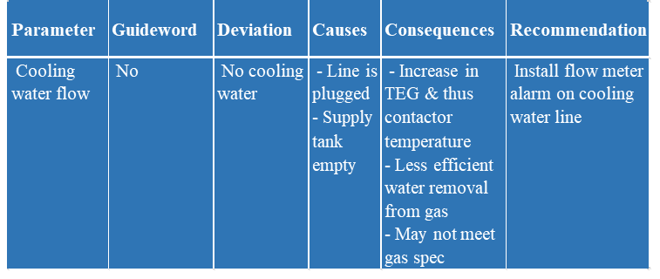
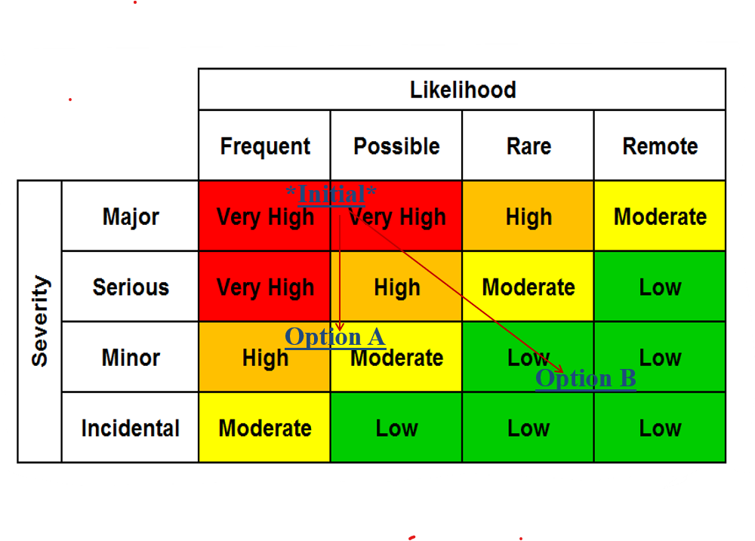
PHAs & Risk Assessments
  Hazard Assessments
  Scenario & non-scenario based
  Checklist, What-If … FMEA, HAZOP
  Risk Assessments
  Criteria, ALARP, …
  Event & Fault Trees, Bow-tie, Matrix
  LOPA & QRA
LOPA Frequencies
Exam Problem: Perform a HAZOP analysis of the heat exchanger on PFD with cooling water and lean TEG, selecting two parameters, two guidewords and two causes for each.
Exam Problem: A chlorine rail loading facility is located 100 m from a sub-division with 400 residents, with a projected line failure with >LC50 every ten years. Plot the existing situation; Option A with a leak detector capable of closing valves and isolating the leak within 5 minutes for $20k; and Option B retrofit eliminating the likelihood of a leak for $250k.

Slide 13
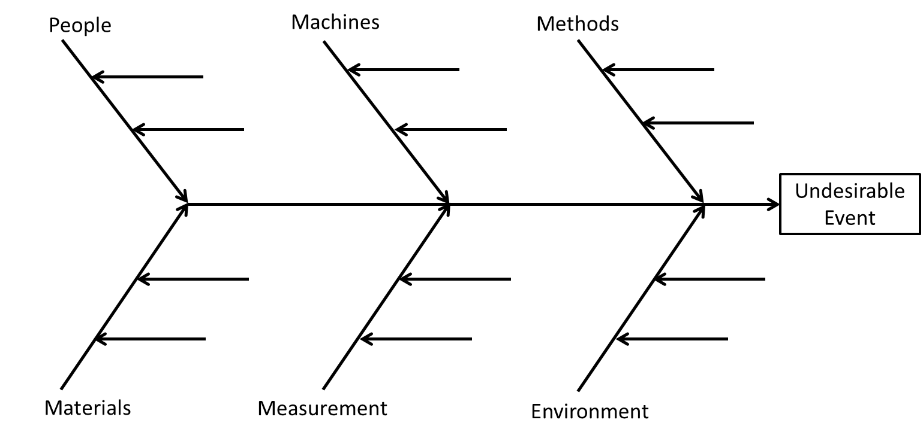
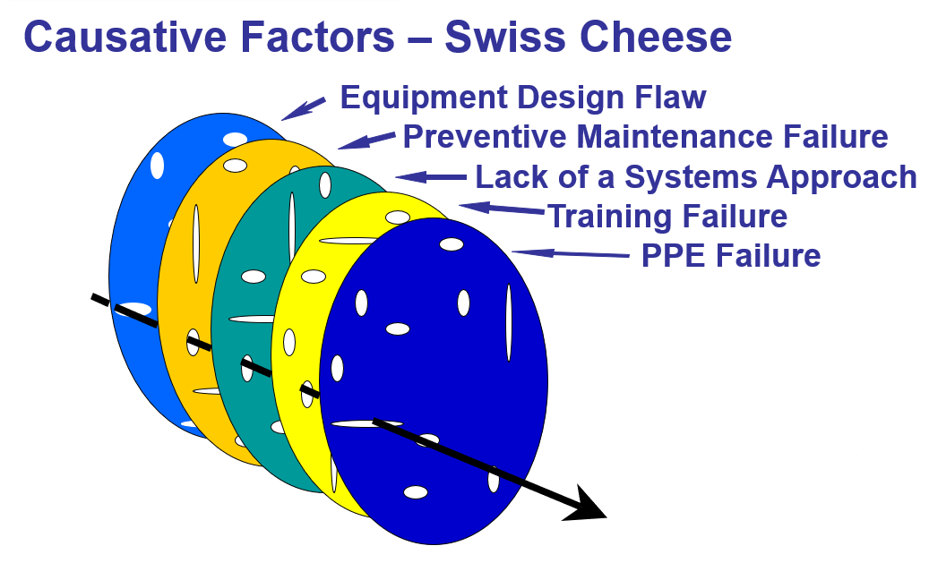
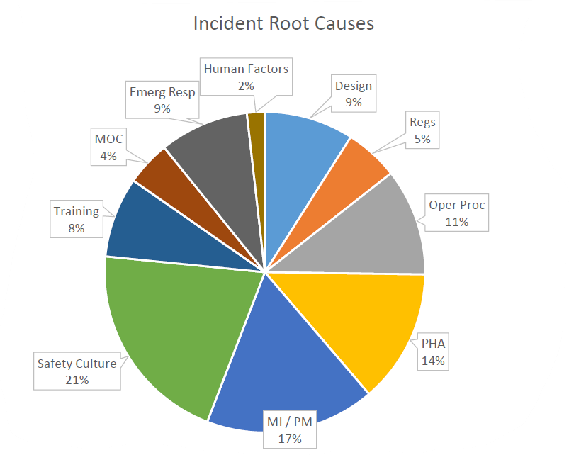
Incident Investigations & Emergency Response
  Incident Investigations, CSB videos …
  Timeline of incident
  Causal factors & root causes
  Students conduct incident investigations using analysis techniques from class; probits, dispersion modeling, blast analysis, .., root cause analysis
  CSB videos shown ~weekly to tie incidents to analysis
  Emergency Response
- People, Environment, Assets & Reputation (PEAR)
- Teams, process and drills
- Internal / external communication & role of LEPCs

Slide 14
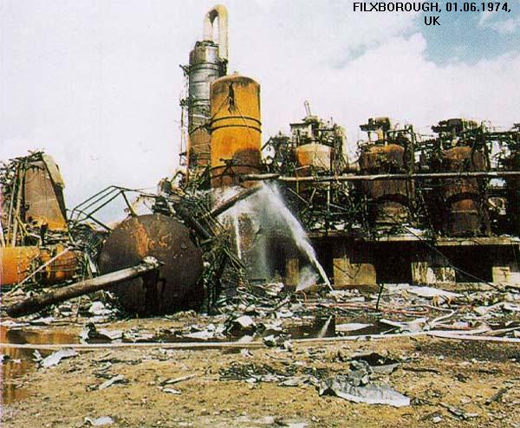
Critical Success Factors for Teaching Process Safety
  Acquire a sense of vulnerability … something bad could happen, with lives lost; accidents are preventable!
  Know enough to know what questions to ask regarding operations … don’t necessarily need to know the answers
  Precursor events for nearly all catastrophic incidents – recognize them
  Meeting regulatory requirements is not enough … YOU must understand the hazards and associated risks of operations
  Recognition that process safety doesn’t solely apply to Chemical Engrs
  Companies ensuring common standards of risk internationally – developing countries / 3rd world

Slide 15
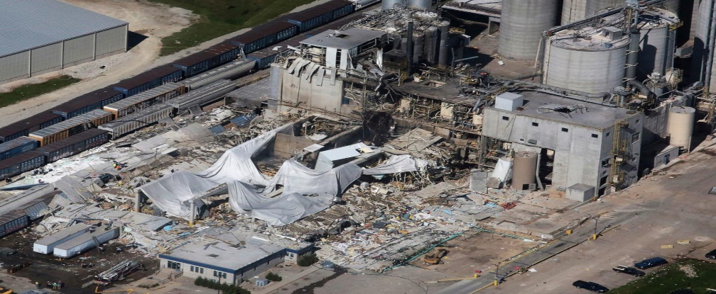
Options
Lecture material is NOT a challenge; available from several sources
- ad hoc quarterly meetings of those teaching or planning to teach PS (see Jerry Forest, Jerry.Forest@Celanese.com)
Fitting Process Safety course into an already crowded ChE curriculum
Options for teaching:
- embed in overall curriculum, Capstone design project or Unit Operations
- dedicated course: 1 – 3 credit hours
Sustainability … faculty rarely have background to effectively teach PS; does it depend on one person or is it distributed among faculty; if distributed, how is it maintained - QA / QC
Desire breath of industry examples to connect with all students

Slide 16
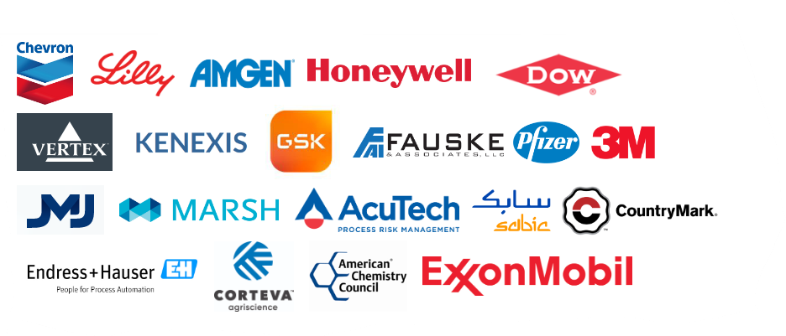
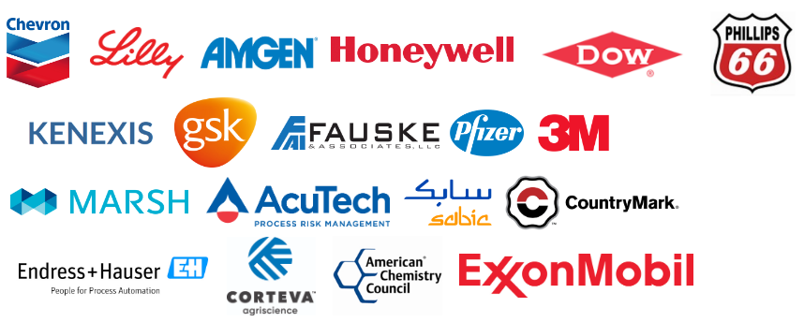
P2SAC Sponsors

